Slide 1
Max

Slide 2
Leo

Slide 3
Tina

Slide 4

Sasha

Slide 5


Slide 8
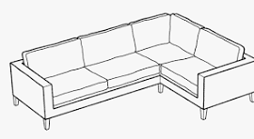

Slide 10
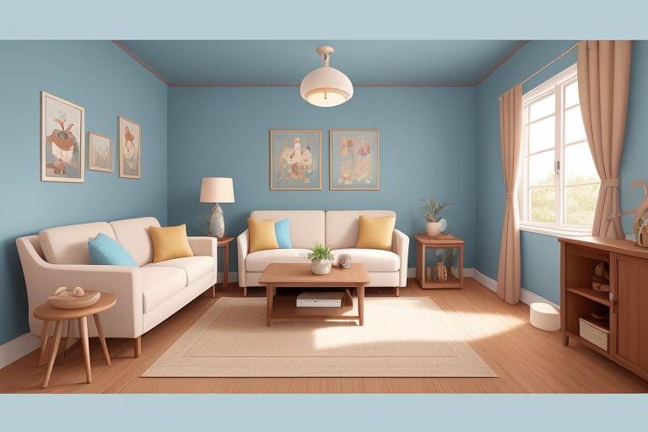

Slide 11
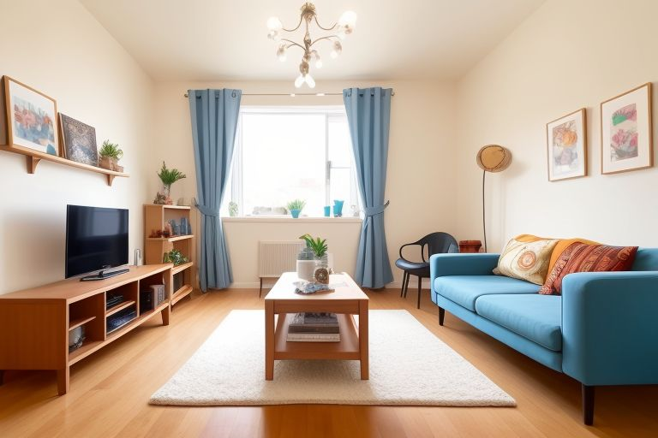

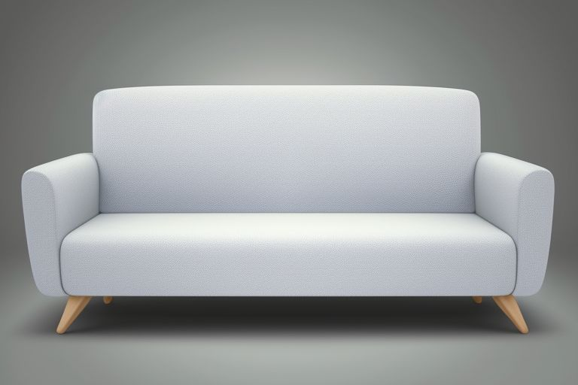

Tina

Slide 12


Slide 13
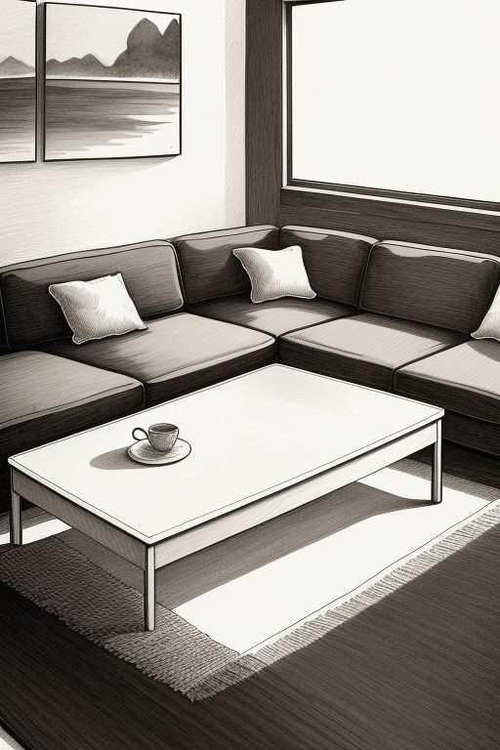

Slide 15

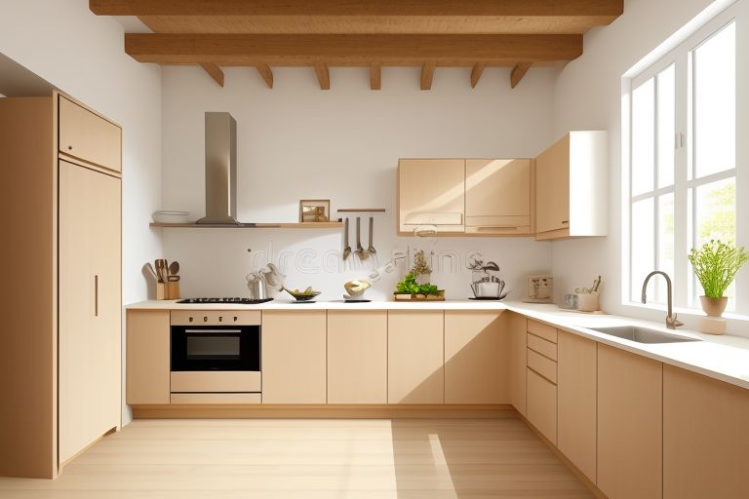

Slide 17
Tina

Slide 18
Laugh Lane - 2

